Slide 1
e- EXAM
PRESENTED BY:
K.HARSHINI(12131A1244)
M.SUSHMITHA(12131A1260)
K.HAREESH(12131A1256)
K.P.PRASHANTH(12131A1243)
Under the guidance of S.KANTHI KIRAN sir

Slide 2
OUTLINE
ABSTRACT
INTRODUCTION
EXISTING SYSTEM
PROPOSED SYSTEM
ARCHITECTURE
UML DIAGRAMS
MODULES
RESULTS
CONCLUSION

Slide 3
ABSTRACT
Online Exam module enables the user to login and take test on which ever course they want via HTTPs, thus analyzing the ability of user by displaying the score . This module enables the customer to identify at which areas they are weak at and improve . It displays the marks and stores them until they retake the exam . As it is an online test it can be used globally .

Slide 4
INTRODUCTION
What is online exam?
A test which is conducted by using a computer device having an internet connection and validate the knowledge.
Online Exam is very important for the assessment of one`s knowledge.
Questions can be changed by the website owner so as to change the level of toughness.
This is can be used in many of educational institutions and used as personal knowledge validators,

Slide 5
PROBLEM STATEMENT
Many people are willing to take online test rather than buying practice text books and spend money for each and every test. Many methods were brought out as a solution for solving this problem. One such good method is providing tests using a website

Slide 6
EXISTING SYSTEM
Pre-Existing user have the capable of login.
Default test exists.
Stores the result without display.

Slide 7
PROPOSED SYSTEM
New user registration available.
Having different test selection.
Globally usable.
capable of attempt different tests at a time.
Instant result of all test.
Capability of rewriting test.

Slide 8


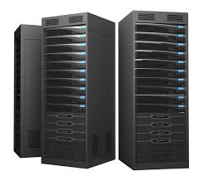





ARCHITECTURE
pc
Server
User
Internet
Data Base

Slide 9
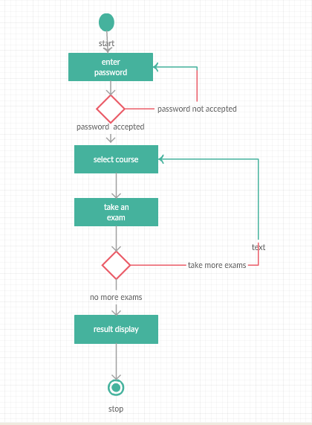
Activity Diagram
Text

Slide 10
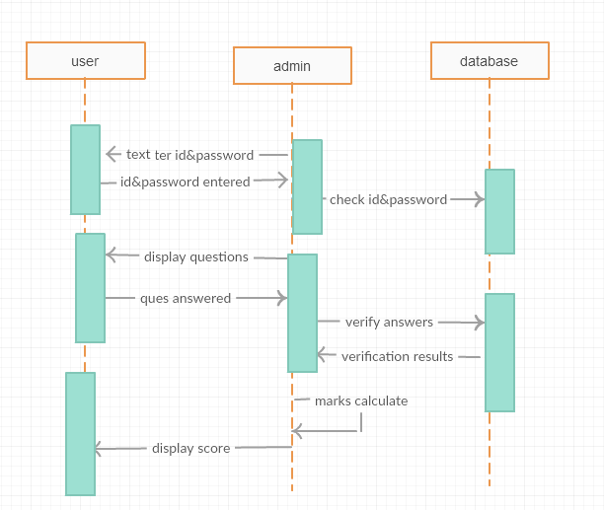
Sequence diagram

Slide 11
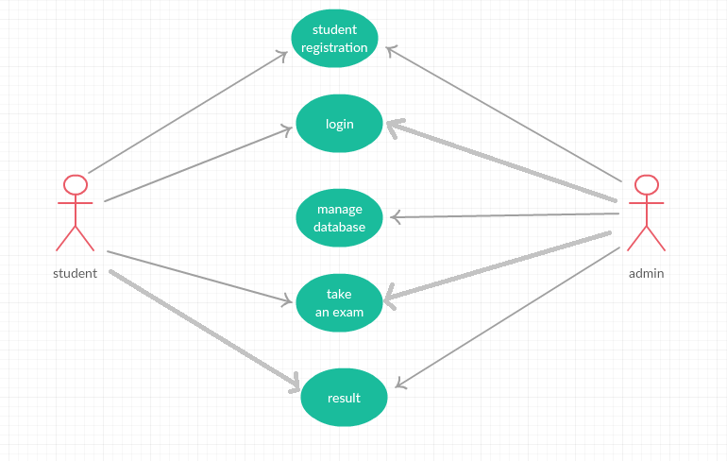
Usecase Diagram
Text

Slide 12
REQUIREMENTS
SOFTWARE REQUIREMENTS:
Operating System : Windows XP, 7, 8.
Database : ORACLE 10g.
Browser Capability : IE7,Google Chrome, Mozilla Firefox
Programming Language : JAVA,HTML
SOFTWARE : APACHE TOMCAT 5.0, NETBEANS7.3
Scripting Language : JAVA SCRIPT
Web Components : JSP

Slide 13
HARDWARE REQUIREMENTS:
PROCESSOR : Intel Pentium 5 and above
PROCESSOR SPEED : 2.4GHZ
MONITOR : COLORMONITOR
HARD DISK : 40GB
RAM : 512MB

Slide 14
REGISTRATION MODULE
New user registration.
Filling the details.
Validation of password.
Reset .
Register me.

Slide 15
LOGIN MODULE
Existing user.
Verification of user inputs.
Pop-ups when user enters wrong
inputs.

Slide 16
SELECTION MODULE
Logout or continue the session.
Selection of course.
Start exam.
Many tests can be taken at one
session.

Slide 17
MARKS DISPLAY MODULE
Display of maximum marks and user marks.
Marks are not displayed when is test not taken.
Display of marks when user
retakes the test.

Slide 18
EXAM MODULE
Displays set of questions for each selected subject
User can select the option
If user does not answer a question it is marked as un answered

Slide 19
User can review the options marked
Answers can be finally submitted

Slide 20
ADMIN MODULE
Can Login in to data base
Create test
Edit question
Set correct option and marks

Slide 21
View the list of students in increasing or decreasing order of marks and evaluate performance
Admin can delete a registered user
Can re-conduct exam for group of users

Slide 22
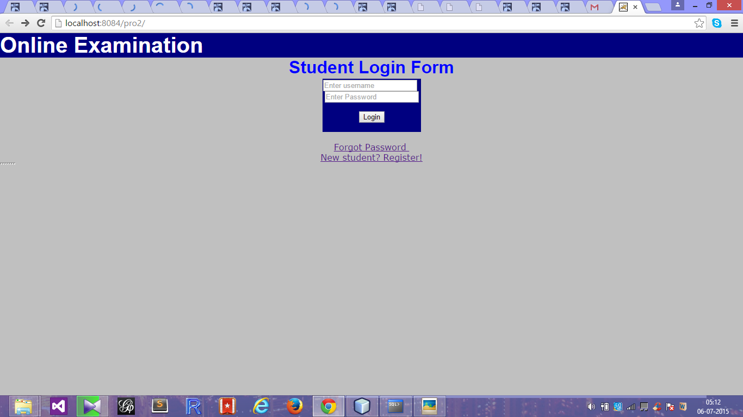

Slide 23
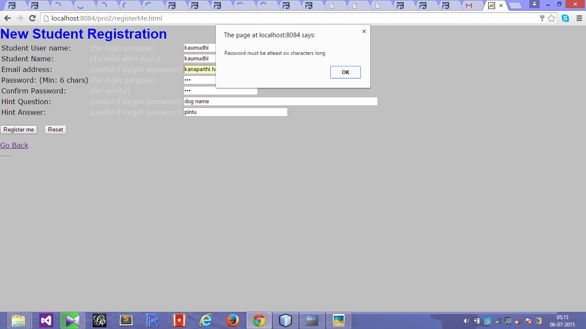

Slide 24
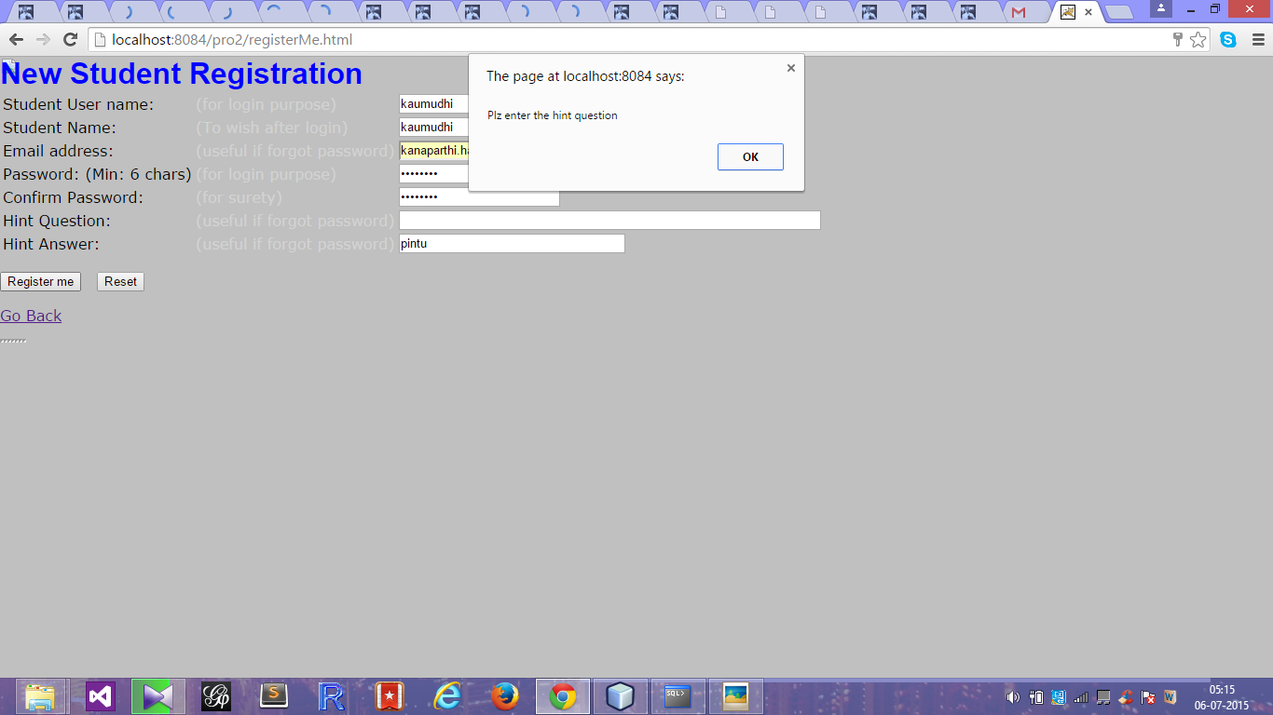

Slide 25
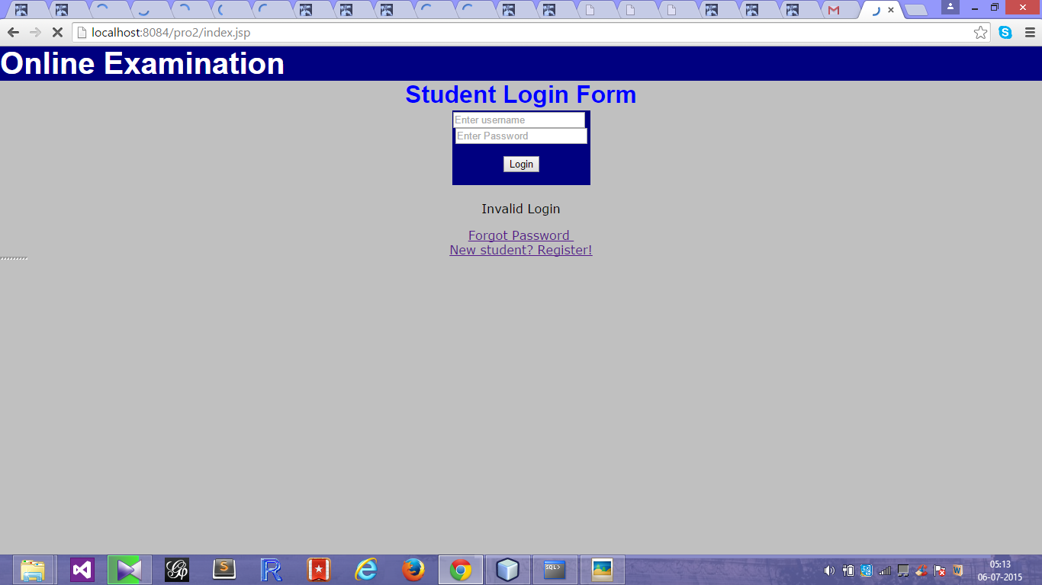

Slide 26
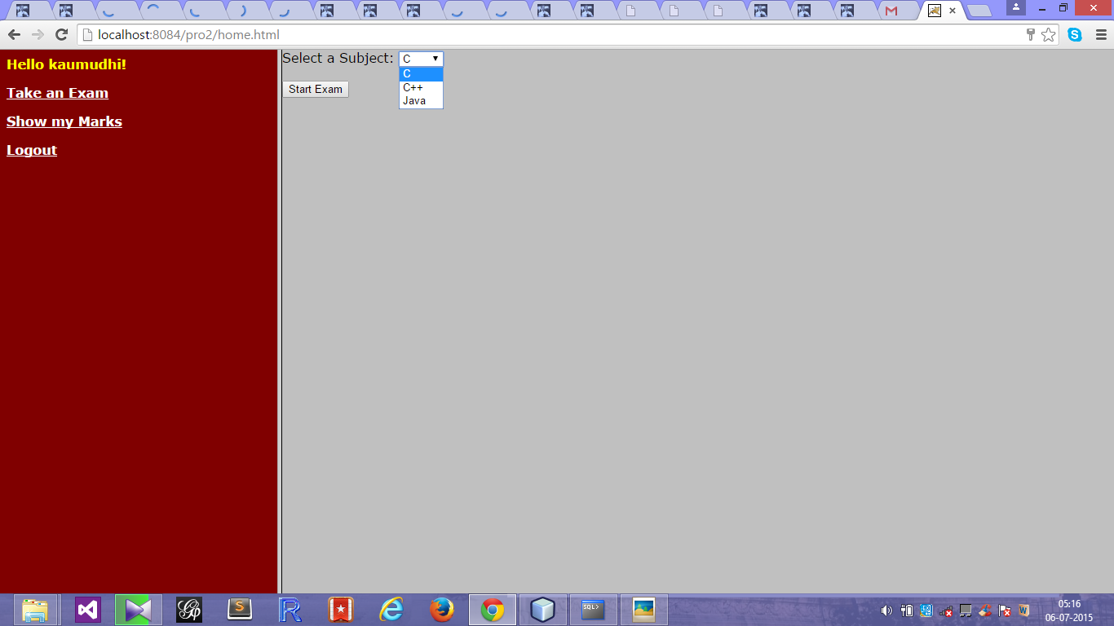

Slide 27
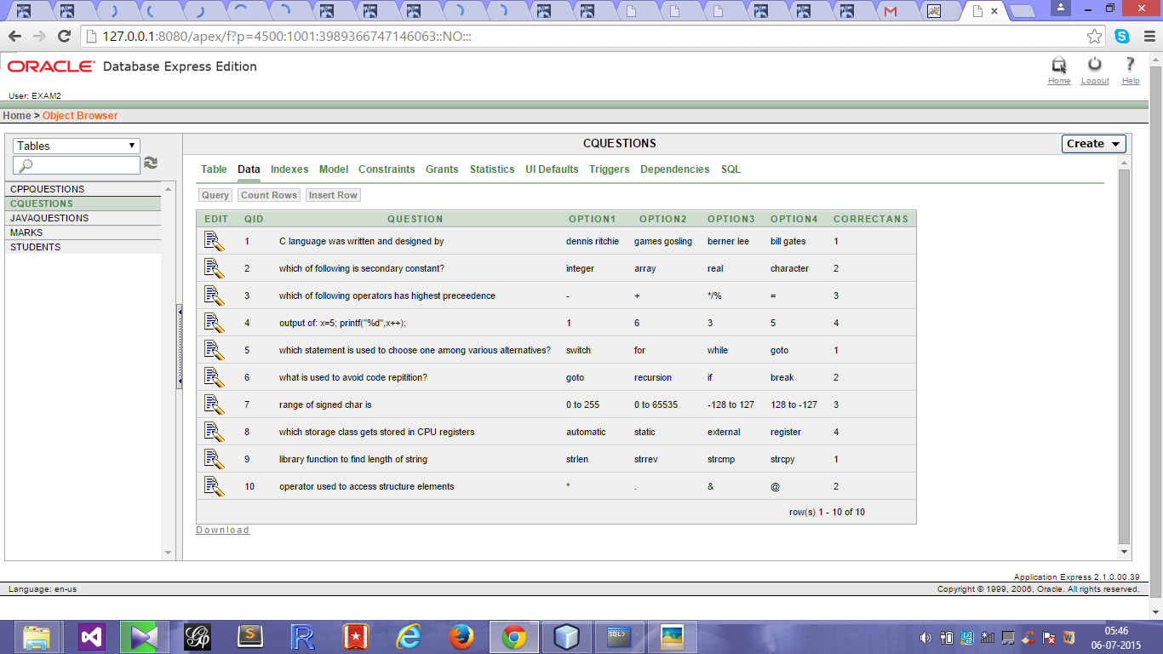

Slide 28
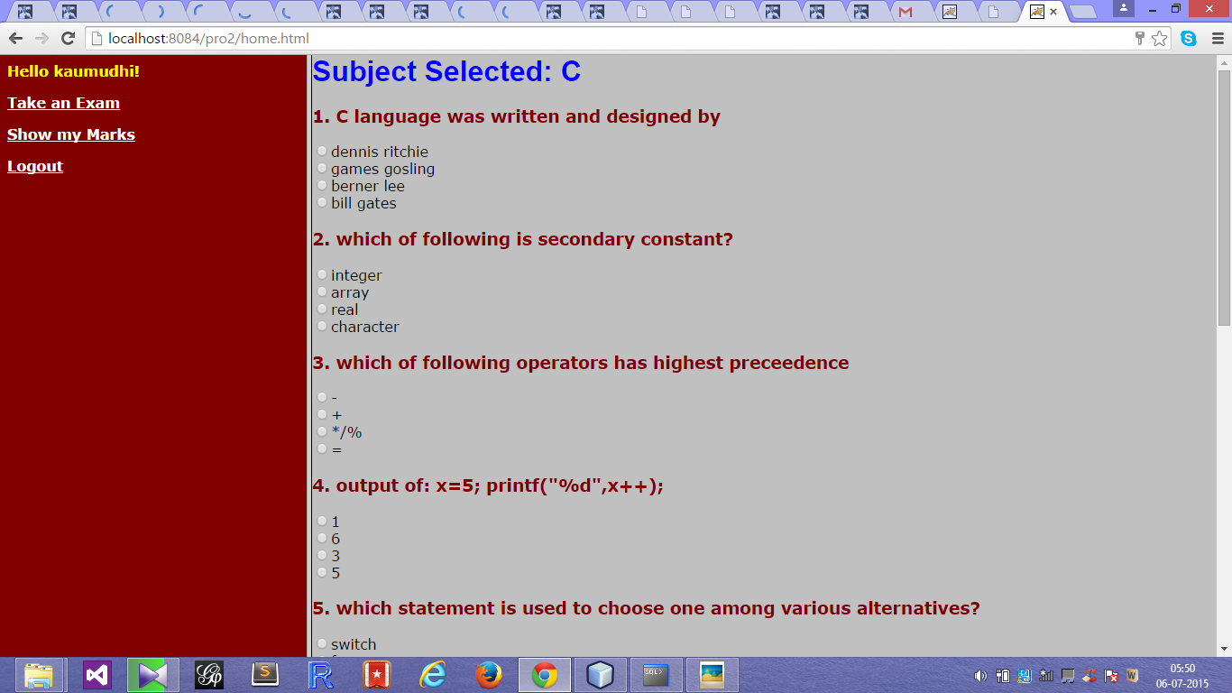

Slide 29
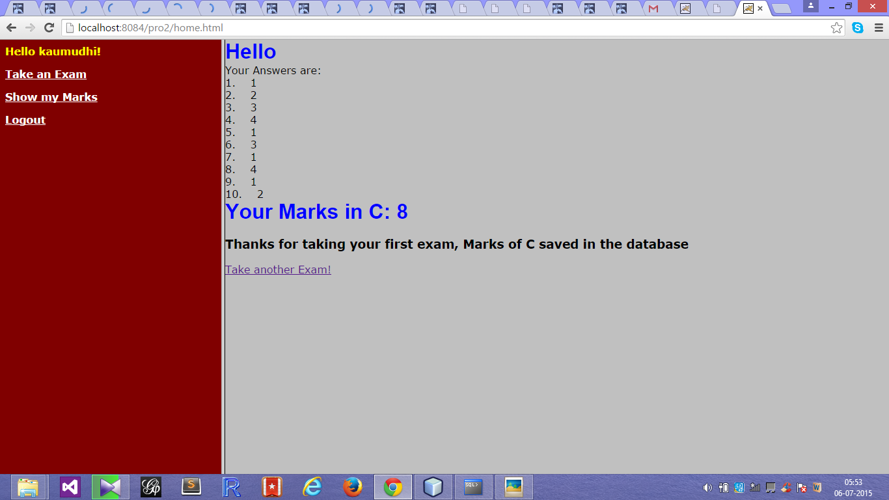

Slide 30
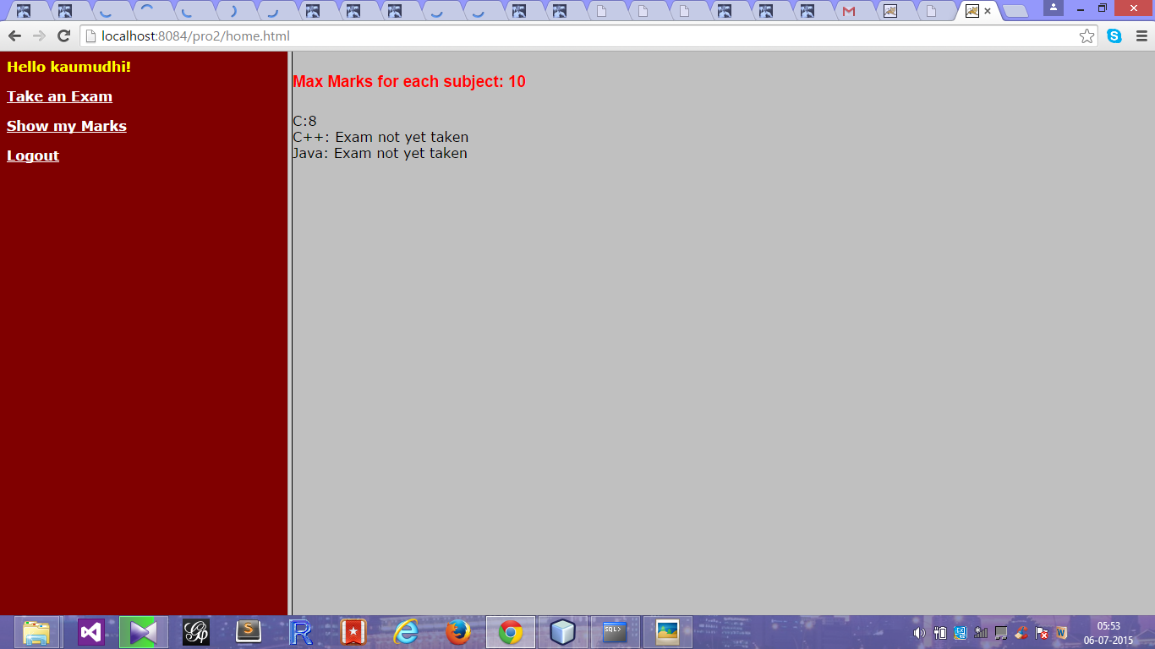

Slide 31
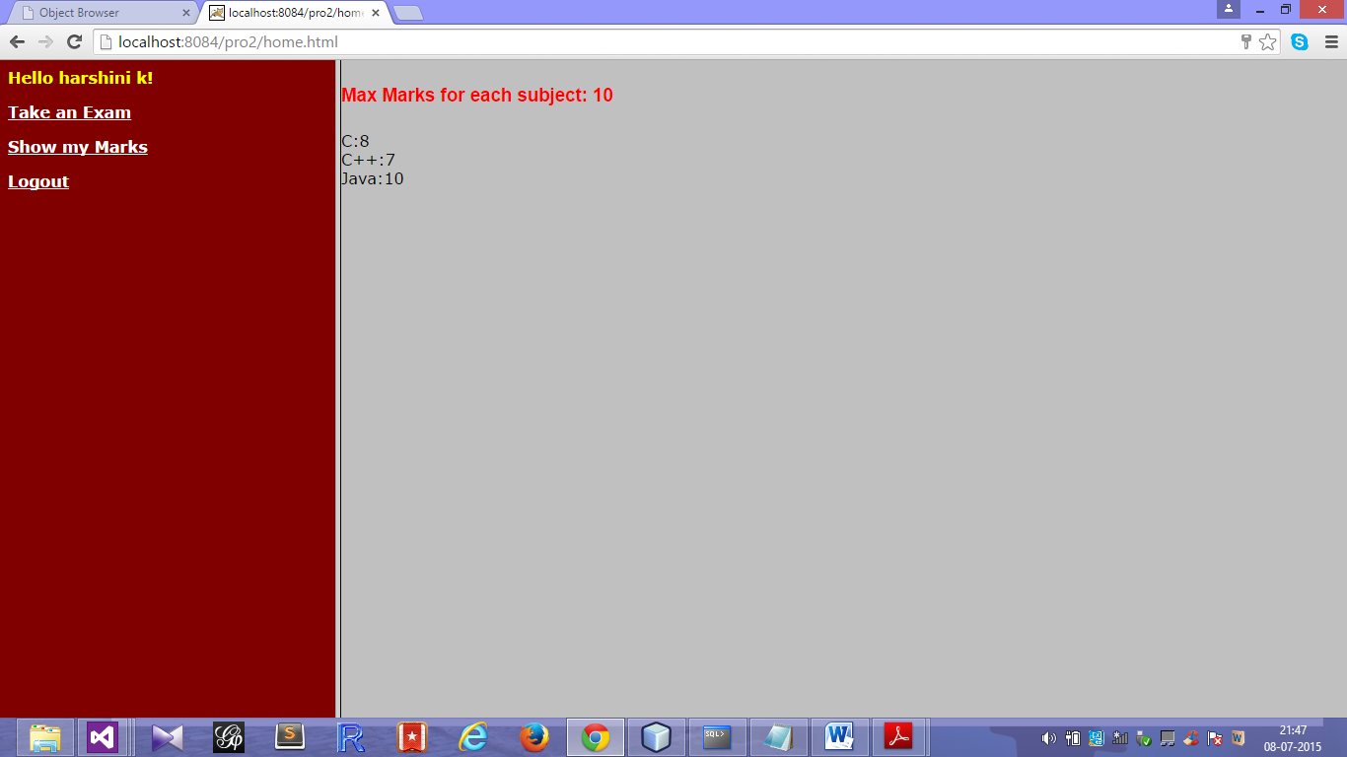

Slide 32
CONCLUSION
Our solution mainly concentrates on providing online tests and store results so that only registered users can enter into their account and have their work done.
Our solution is useful to the user to asses his/her knowledge on the chosen subject .
This module provides the best way for educational institutes located at different places in the world .
This Online Examination System developed using Javascript, HTML, and SQL fulfills the basic objectives of the system for which it has been developed.
The system is operated at a high level of efficiency and its advantage is quite understood.

Slide 33
REFERENCES
Texthttp://www.w3schools.com/html/default.asp
The Complete Reference Java 7th Edition by Herbert Schildt
http://www.jsptut.com/
Internet and world wide web by Dietel and Nieto
Java server pages by Hans Bergsten
Sql and pl/sql for oracle 10g,black book,Dr.P.S.Deshpande

